Slide 1
Topic 2 - A Growing Concern
Pesticide use is now common practice worldwide. Herbicides control weeds, insecticides control insects and fungicides control diseased crops. The use of chemicals, such as DDT, was originally thought to be directed only at the insects it was intended for. Unintentional harmful effects to other species resulted in a closer look.
http://www.ctvnews.ca/health/not-so-sweet-death-critics-call-on-canada-to-ban-pesticide-linked-to-dwindling-bee-populations-1.1266763

Slide 2
Issues Associated With the Use of DDT
The invention of DDT by Swiss chemist Paul Müller was seen originally as a breakthrough in medicine.
Typhus -transmitted by lice- which wiped out Napoleon’s army in the 1800s, was rampant during World War II among the Allied troops. DDT wiped it out. It proved to be so effective that Müller was awarded the Nobel Prize in Medicine for his discovery. During the 1950s it was used to try to control an outbreak of malaria.

Slide 3
The DDT Story
When DDT gets into the food chain bioaccumulation can have devastating effects. As you move up the food chain the concentrations of DDT are higher.
http://www.youtube.com/watch?v=E5P-UoKLxlA

Slide 4
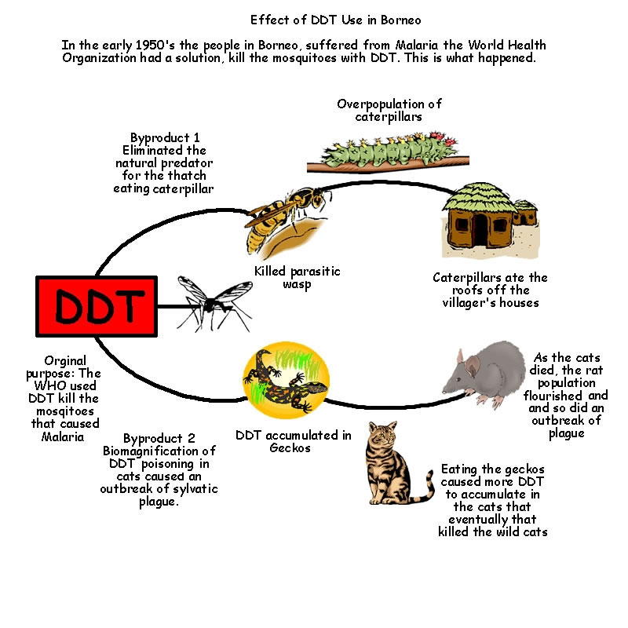

Slide 5
What’s Bugging You?
The use of DDT was recognized as having potentially harmful effects. Banning its use would also negate the positive effects it was having in controlling malaria (In Zanzibar alone – the incidence of malaria dropped from 70% to 5% over a 6 year span). When a restriction on the use of DDT was implemented in 1984, the incidence of malaria returned to the 50-60 % level. Nothing else proved to be as effective in controlling the insects that carried malaria.
http://www.youtube.com/watch?v=LuWh-iTG1ds
Should DDT be banned completely?
Producing safe and effective insecticides, as alternatives to DDT is difficult due to cost, effectiveness and the problem of resistance.

Slide 6
Where To Now?
No matter how it is developed, a pesticide (insecticide) is used to control pests. The potential these chemicals have to harm non-target species has caused concern and restraint on the widespread and uncontrolled use of pesticides in the environment. Research and development into newer and safer pesticides has resulted in these pesticides breaking down faster in the environment after they have been applied. It is now widely recognized that natural processes and cycles can minimize the effects of these pesticides, but it still remains a hotly debated issue. In the future researchers must determine what effects combinations of these pesticides will have on the environment and ultimately us.

