Slide 1
Light and Optical Systems

Slide 2
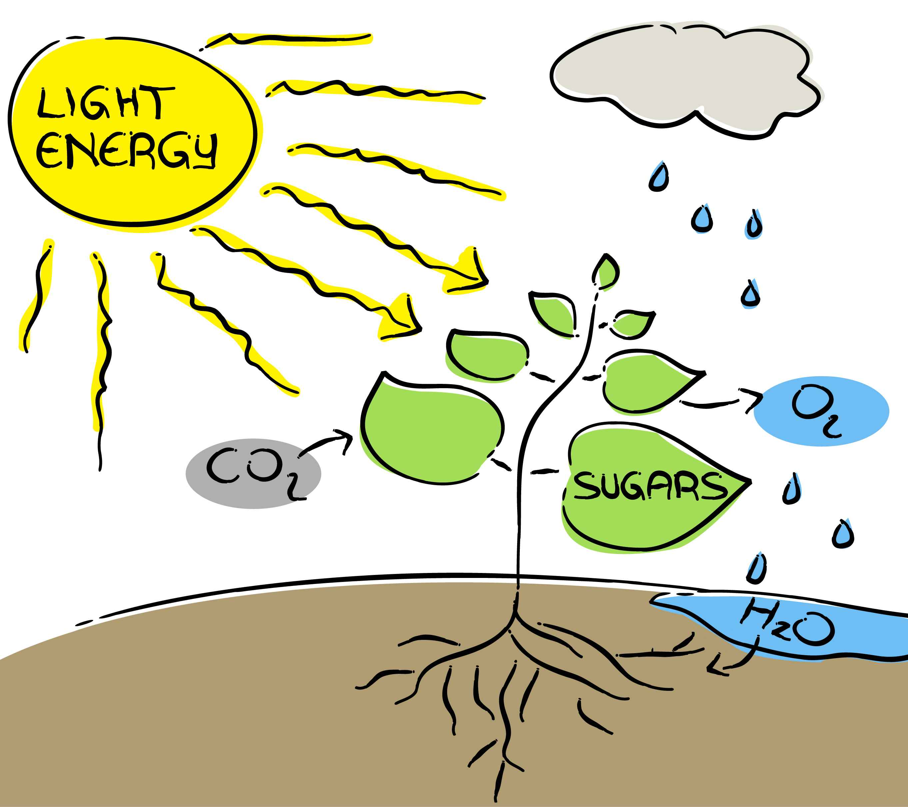
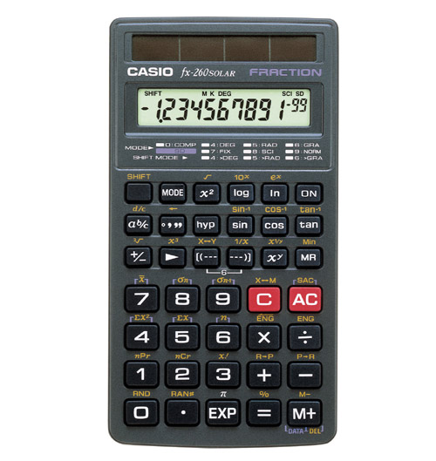
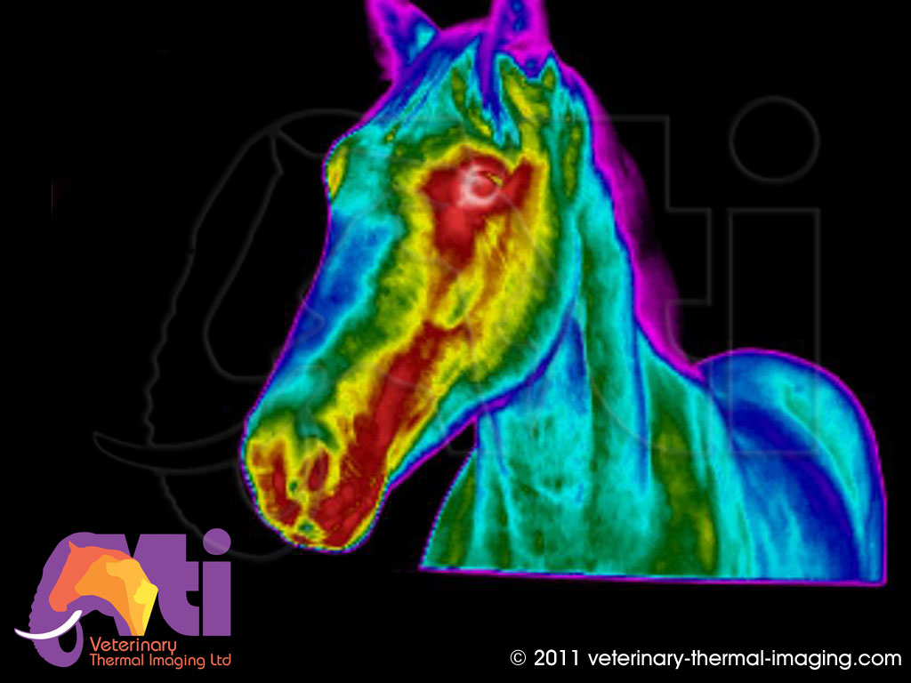
Topic 1: What is Light?
The First Basic Principle of Light
Light is a form of energy.
When light reaches a surface, it can be absorbed and transformed into other types of energy.

Slide 3
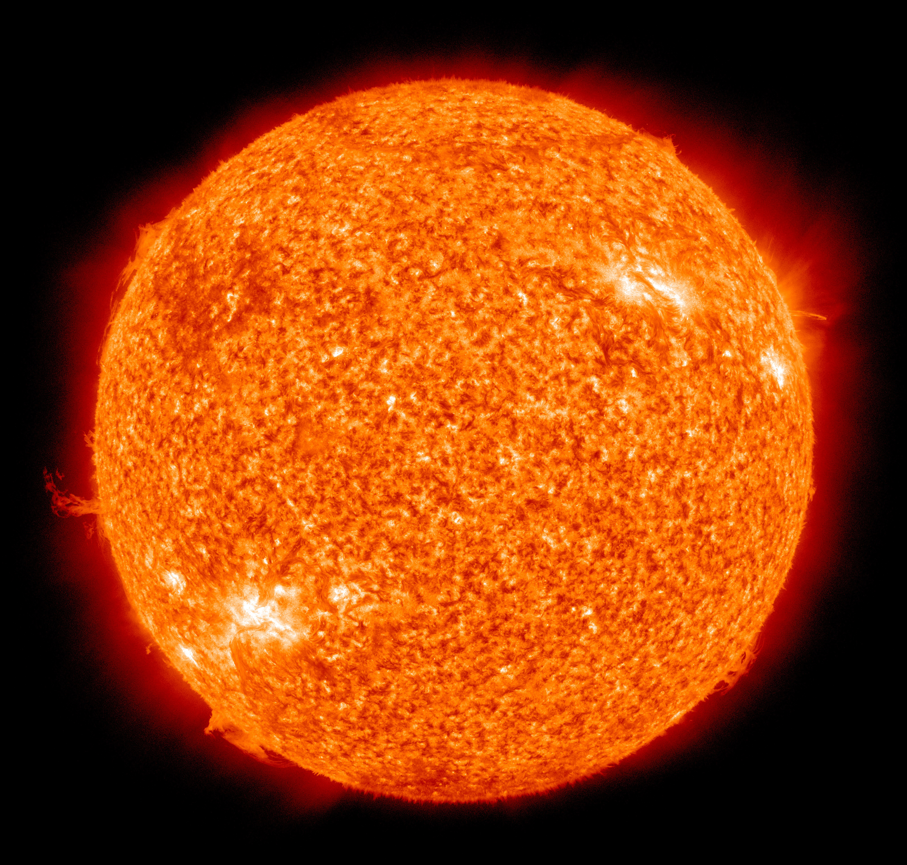
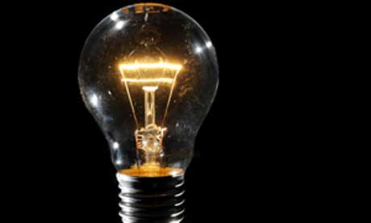
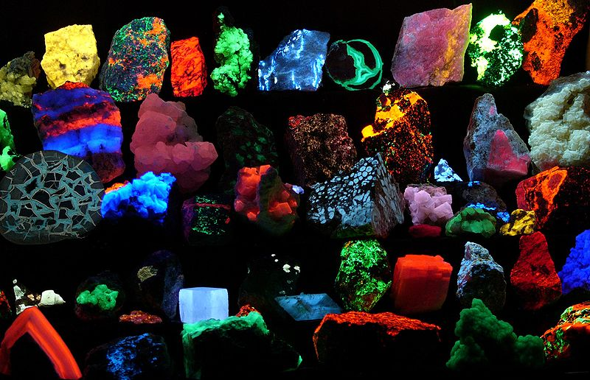
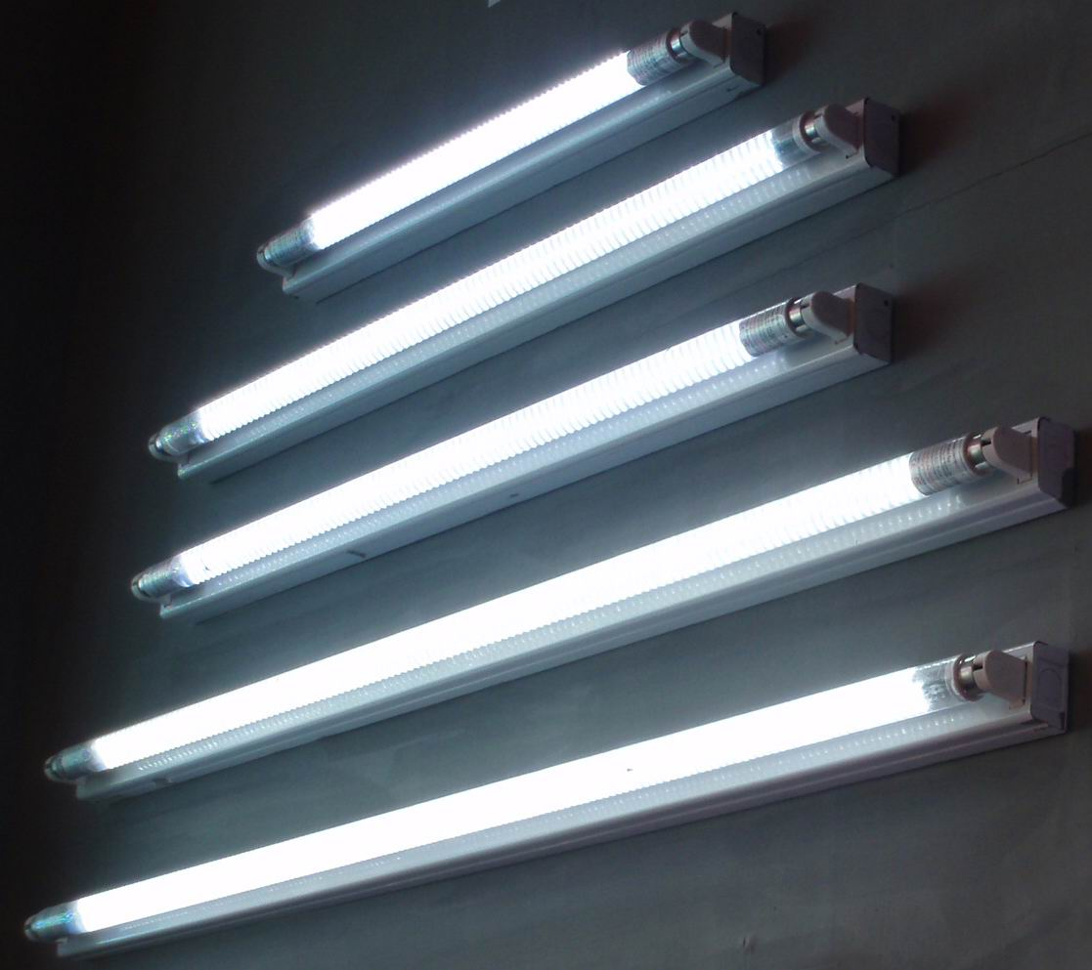
Natural Light Sources Artificial Light Sources
Sun Incandescent Light Bulb
(heat causing a filament of metal to glow – visible light)
Minerals Florescent Florescent Tube
(ultraviolet light is absorbed by fabric particles,
which in turn emit some of the energy as
light – glowing)

Slide 4
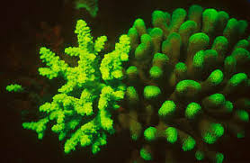
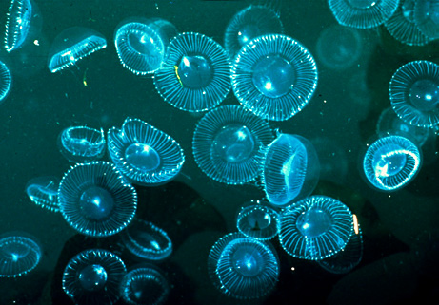
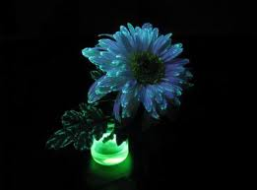
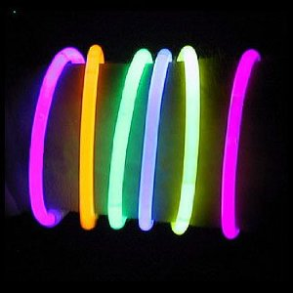
Coral Phosphorescent Glow in the dark toys
(light energy is stored and released
later as visible light)
Jellyfish Bioluminescence Injected Plant life
(light produced by living organisms)
N/A Chemiluminescent Glow Sticks
(light energy released by chemical reactions)

Slide 5
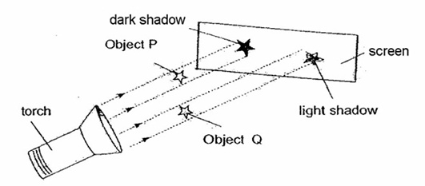
https://www.youtube.com/watch?v=9HXXQBz6Vv0
The Cost of Lighting: See Handout at the end of this section of notes
The Ray Model of Light
Light travels in straight lines
A ray is a straight line that represents the path of a beam of light. The ray model helps to explain how shadows can be formed, when the ray of light is blocked by an object.

Slide 6
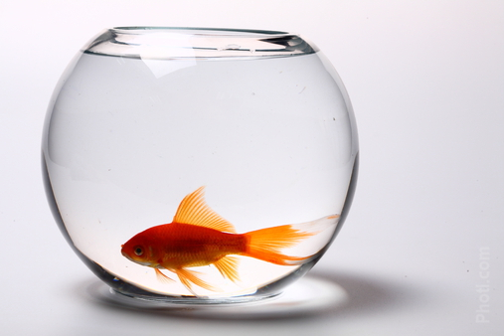
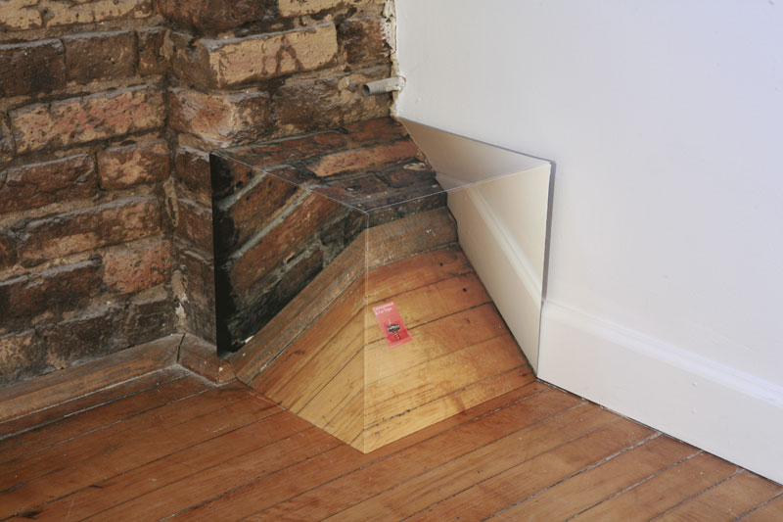
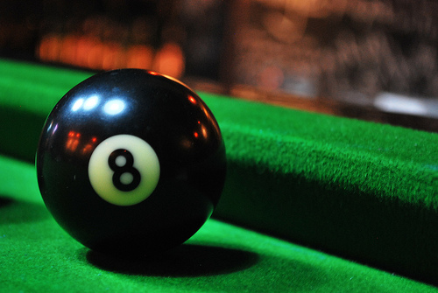
If the surface is transparent, the light will continue in a straight path through the object
If the surface is translucent, the light will be
diverted (refracted) after it passes through
If the surface is opaque, the light will be blocked and not allowed through the object
https://www.youtube.com/watch?v=QP-ny3fYcZ0

