Slide 1
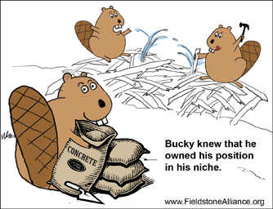
Topic 2: Habitat and Lifestyle
Variations are not just physical differences. Variations can be the roles organisms play and how well they “play” them.
Niches are what makes organisms who they are. A niche is an organism’s habitat, (where it lives), and what it does.
http://www.youtube.com/watch?annotation_id=annotation_757980&feature=iv&src_vid=bswS-Ooe4iQ&v=xIVixvcR4Jc

Slide 2
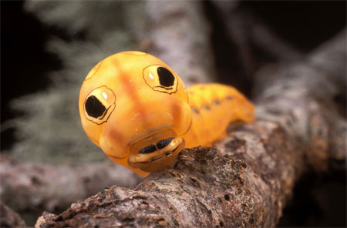
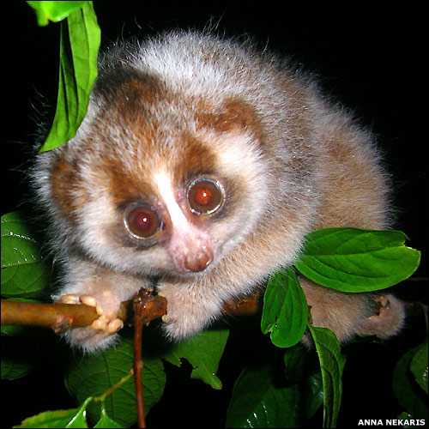
Variation and Competition
Competition occurs when basic resources are in demand, (scarce). It can be between members of the same species or between different species. When a competition takes place variations between the organisms involved can give one an advantage and the other a disadvantage. (Whether they belong to the same species or not.)
The better adapted organism in the competition will have a higher reproduction rate and can eventually “conquer” the habitat. The less successful organism would have to change food sources or move to another habitat in order to survive.
Certain species avoid competition by eating a different food source or by altering their behaviours. These changes effectively change their niches and increase the variation within the species.
Loris
Orange Spicebush caterpillar

Slide 3
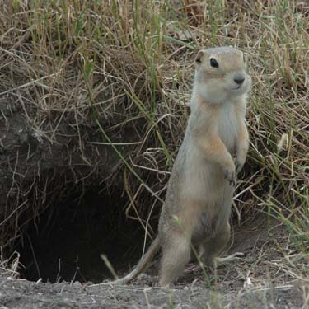
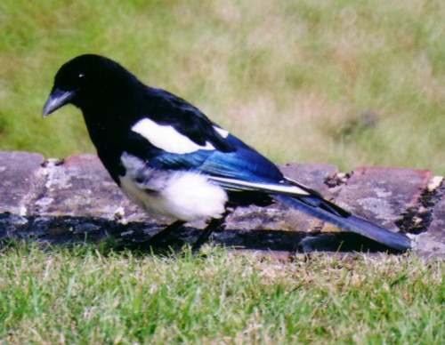
The Broad Niche
In order for animals to survive the Canadian ecosystem they must have a broad niche. They must be able to adjust their diet depending on the seasons and changing conditions. They must have adaptations that allow them to survive major temperature differences. Canadian species are typically generalists. This allows them to grow to a large population and spread over large areas. Our ecosystem tends to have low diversity, but it includes large numbers of the species.

Slide 4
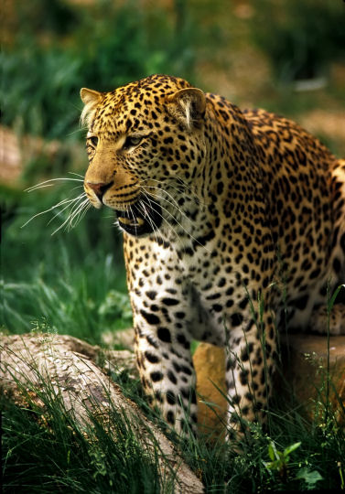
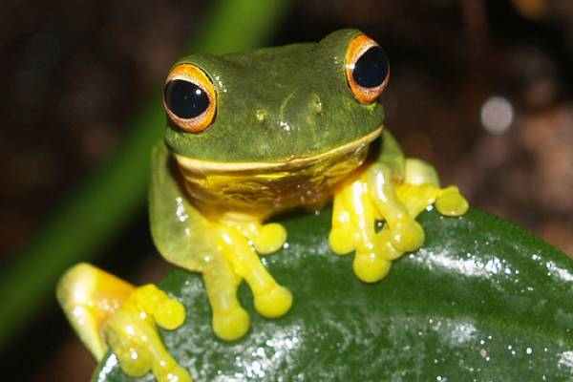
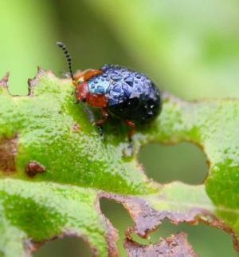
Diversity in the Tropics: The Dangers of a Narrow Niche
Areas that have temperatures and food supplies that do not change contain organisms that are specialists. These specialists perform their specific roles well but have very narrow niches. (They are adapted well to obtaining one food source) Since the organisms are specialists there can be many different species in one habitat but a single species cannot spread over a great area. The tropics will have areas with very high diversity but with low populations. This can be dangerous because if the conditions of the species environment change the specialist cannot adapt nor move to another habitat. Since the populations of the species are small to begin with they deplete more quickly than generalists.
Orange eyed tree frog
Leaf beetle
http://www.youtube.com/watch?v=bswS-Ooe4iQ
Jaguar

Slide 5
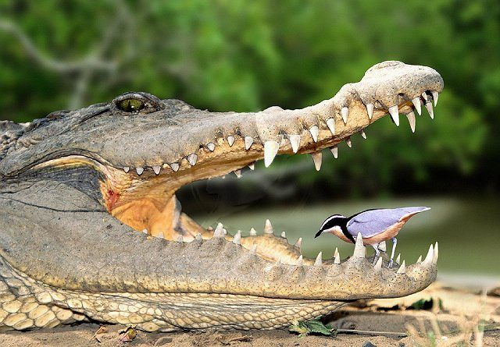
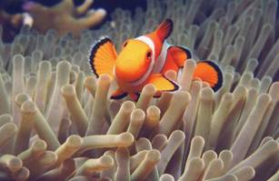
Dependencies Between Species
Symbiotic relationships:
Mutualism: The relationship benefits both species.
Commensalism: The relationship benefits one species the other is not affected.

Slide 6
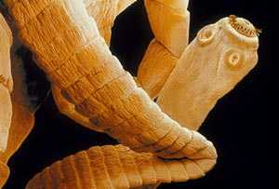
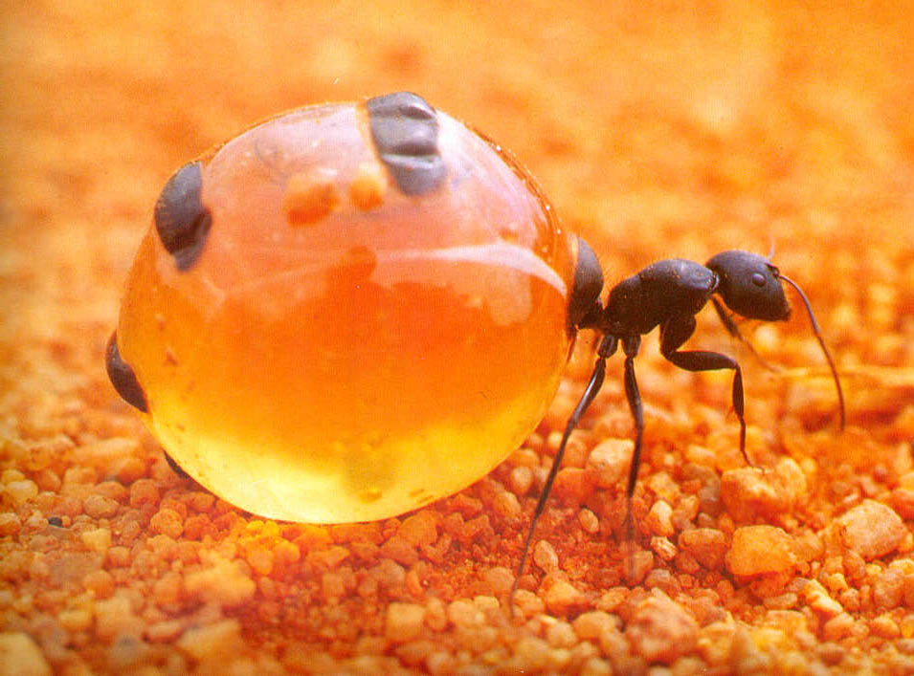
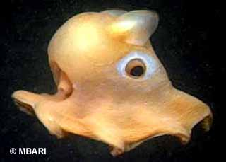
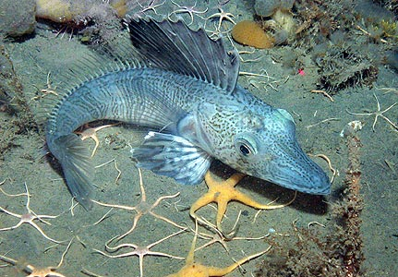
Parasitism: The relationship harms one species, (host), while benefiting the other (parasite).
Life in the Extreme
Certain organisms are adapted to living in extreme environments, (heat, cold, darkness etc.) Many of the adaptations are not understood by Science as of yet.
Honey Pot Ant
Dumbo Octopus
Antarctic Ice Fish

