Slide 1
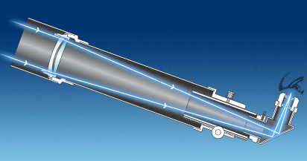
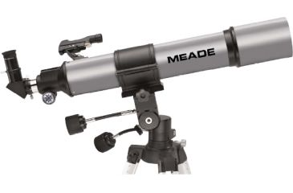
Topic 5 – Extending Human Vision
Tools have been developed, to extend our vision, enabling us to see tiny micro-organisms, far-off distances and the vast reaches of outer space.
Telescopes
Telescopes help us to see distant objects more clearly. In a refracting telescope, light from a distant object is collected and focused by a convex lens called the objective lens. A second lens, called the eyepiece lens, works as a magnifying glass to enlarge the image.

Slide 2
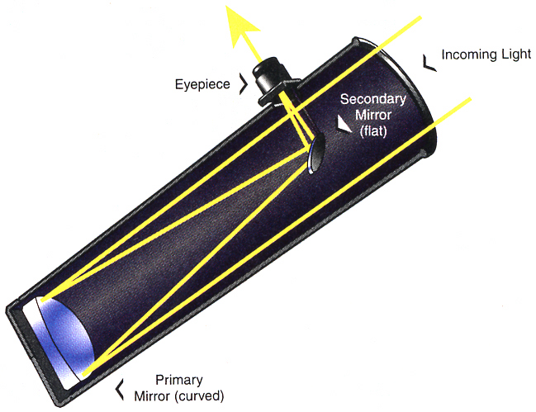
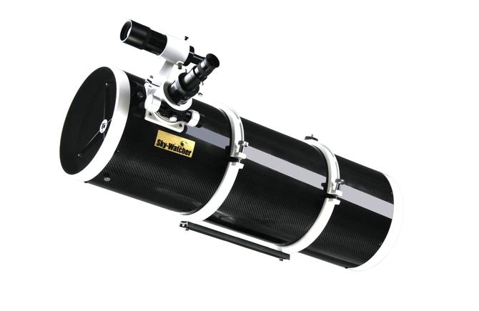
A reflecting telescope uses a concave mirror to collect rays of light from a distant object. This mirror is called the primary, or objective mirror, which forms a real image magnified by the eyepiece lens.
The lens in a refracting telescope and the mirror in a reflecting telescope collect as much light as possible from distant objects. These collectors then focus the light into an image. The further away the image is from the lens, or the mirror, the greater the magnification. For the greatest magnification the telescope needs to have as large a distance as possible between the object being viewed and its image.
http://www.youtube.com/watch?v=WvLspPgC1EU&list=PLKoX2PlSGEk8BS6WZEyIBVsgtTOtjZeTL&index=3
http://www.youtube.com/watch?v=jhEBKr7rV18

Slide 3
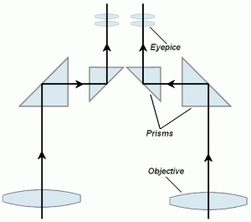
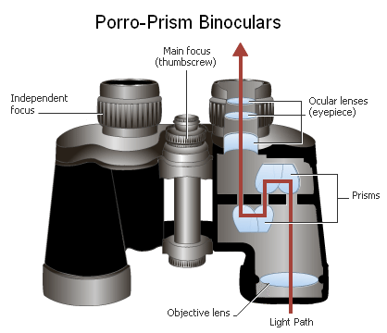
Binoculars
Binoculars are actually two reflecting telescopes mounted side by side. In binoculars, the telescopes are shortened by placing prisms inside, which serve as plane mirrors. In this way, the light entering the binoculars can be reflected back and forth inside a short tube.

Slide 4
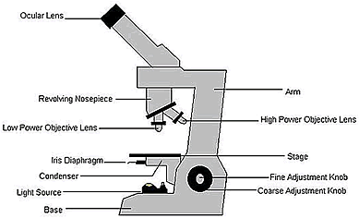
Microscopes, Telescopes and Scientific Knowledge
A magnifying glass is a very simple microscope, which typically magnifies about 10 times. In 1676, a Dutch scientist, Anton Van Leeuwenhock used a simple convex lens to view bacteria (magnified about 280 times).
Compound microscopes have an objective lens that forms a real image of the object, which is then magnified by an eyepiece lens. Usually more than one objective and eyepiece lens are used to increase the magnification and improve the sharpness of the image.
http://www.youtube.com/watch?v=-Ew_6JIqU-s

Slide 5
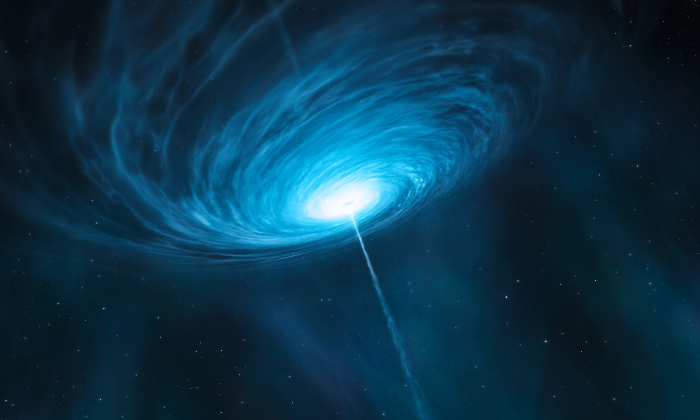
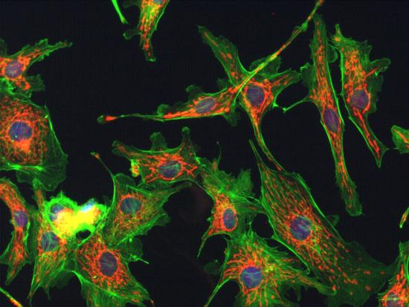
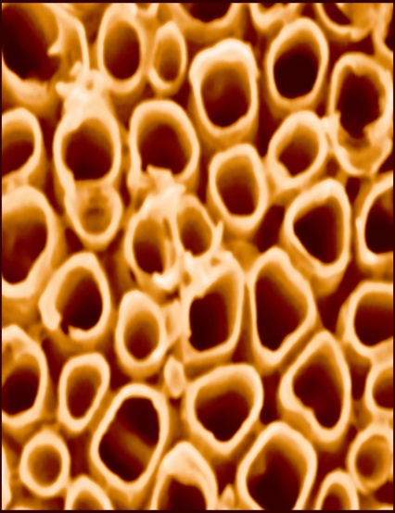
New Discoveries
Scientists have learned many new things as a result of the development of microscopes and telescopes. Living tissue is composed of living cells, in which functions and reproduction can be viewed, as well as activity in relation to cancerous growth and destruction by viruses. Scientists can also now study the genetic make-up of cells.
Similarly, the improvements in the telescope have opened up the universe for viewing and study. Telescopes and microscopes have their limitations, which reveal the nature of light.

