Slide 1
Topic 8 - People In Space
Space travel can have its dangers. A launch can be affected by many dangers, including highly explosive fuel, poor weather, malfunctioning equipment, human error and even birds. Once in flight, the spacecraft can be affected by floating debris, meteoroids and electromagnetic radiation.
Micrometeorites are constantly bombarding spacecraft and the International Space Station. They travel at extremely high velocity and can cause great damage. Once they enter the atmosphere, they usually burn up.

Slide 2
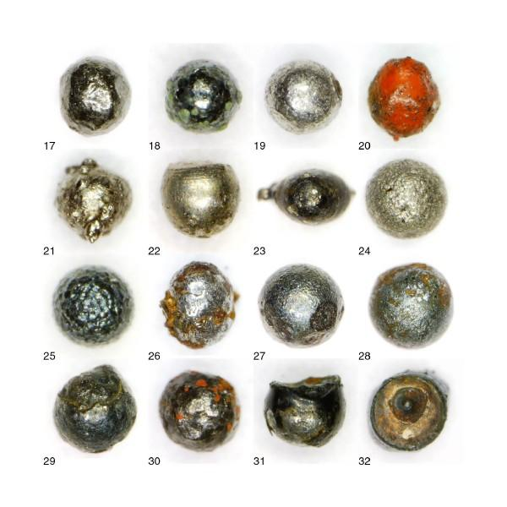
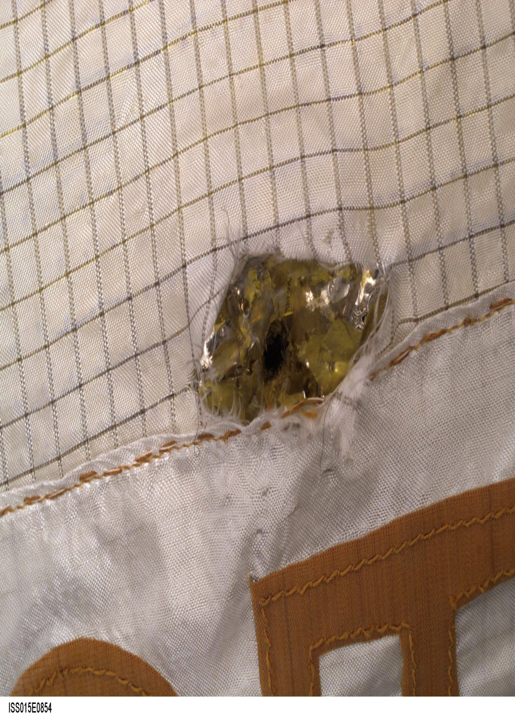
Micrometeorites
Damage to the International Space Station from a micrometeorite

Slide 3
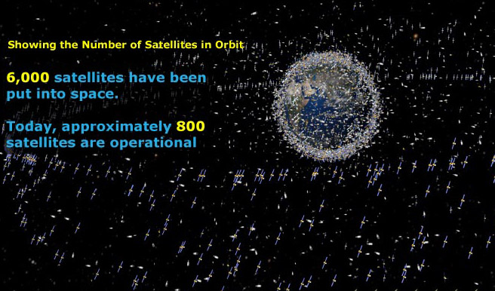
Space junk refers to all the pieces of debris that have fallen off rockets, satellites, space shuttles and space stations that remain in space. This can include specks of paint, screws, bolts, nonworking satellites, antennas, tools and equipment that is discarded or lost. Some debris in space will enter the atmosphere and will not totally burn up. When this occurs, it may land in populated areas and cause loss of life or damage to property.
Some satellites, or decommissioned space stations, that re-enter the atmosphere have radioactive parts and can contaminate a very large area, costing a lot of money and hours to clean it up. Some burn up in the atmosphere and those parts that don’t fall into the ocean, making recovery and clean-up less costly.
http://www.youtube.com/watch?v=JpRRgipIO8A&feature=related

Slide 4
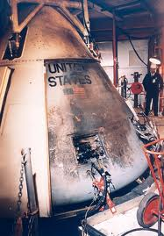
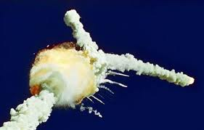
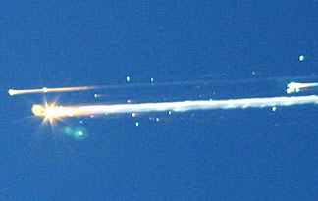
Breaking Free of Earth’s Gravity
The energy it takes to get up into orbit and stay there is huge. Gravity must be overcome! This is called escape velocity. Even when the gravity of the Earth is overcome, there are other hazards in this ‘unfriendly to humans’ space environment, which can cause a mission to fail and possibly be a disaster, resulting in loss of life, economic setbacks and many years of work.
There are tragedies that bring to life the true dangers of space travel, such as:
1967 Apollo 1 1986 Space Shuttle Challenger 2003 Space Shuttle Columbia

Slide 5
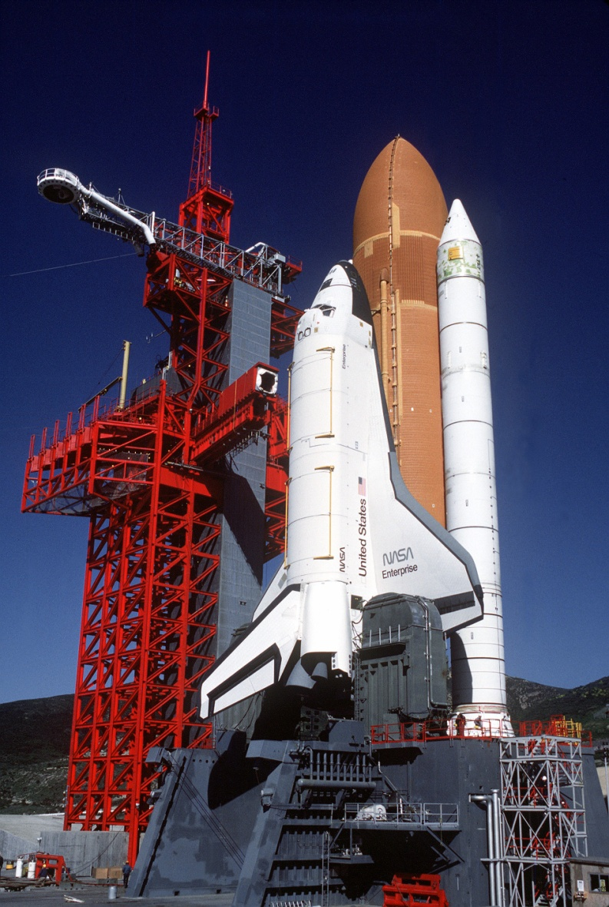
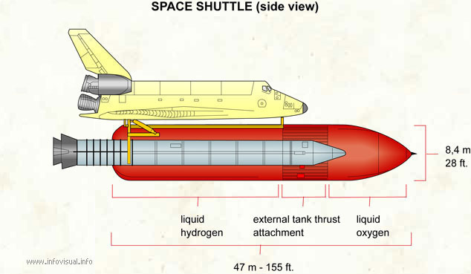
Shuttle, Space probes and Space Stations
There are three main types of spacecraft in use:
Shuttles transport personnel and equipment to orbiting spacecraft. Columbia was the 1st in 1981

Slide 6
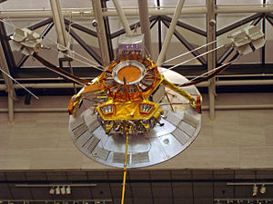
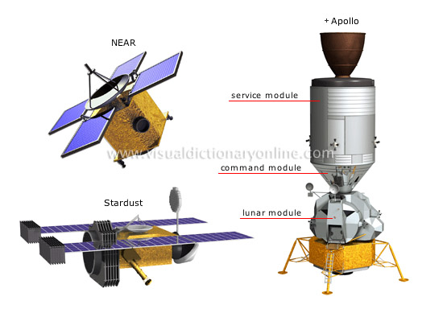
2. Space probes carry instrumentation for exploration of space.

Slide 7
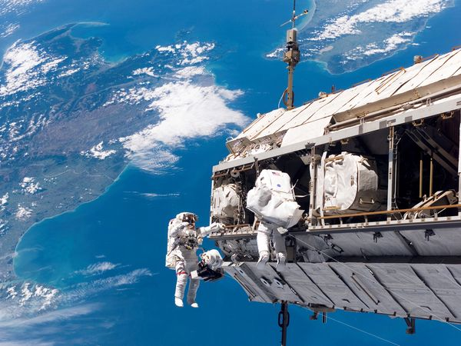
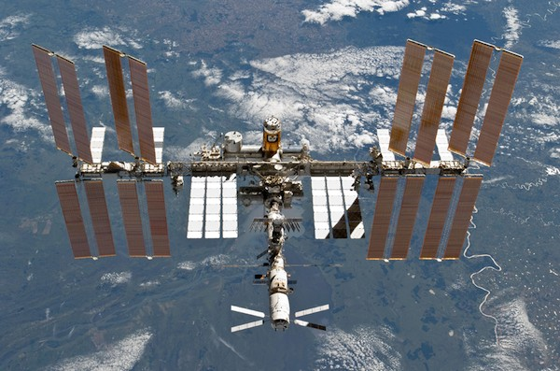
3. International Space Stations are orbiting space centers where research, experimentation, and further exploration can be carried out by people living there for extended periods of time.

Slide 8
Canadarm
launched in 1981
Purposes:
launching and retrieving satellites for use or repair
fixed the Hubble Telescope
Put modules of the International Space Station together
http://www.youtube.com/watch?v=ck76yL_s30s&feature=related
The Future of Space Transport Technology
Ion Drives are engines that use xenon gas instead of chemical fuel. The xenon is electrically charged, accelerated, and then released as exhaust, which provides the thrust for the spacecraft.
http://www.youtube.com/watch?v=YTbPI2PxLUE&feature=related
Solar Sail Spacecraft
They harness the light of the Sun. The Sun’s electromagnetic energy, in the form of photons, hits the carbon fibre solar sails, and is transmitted through the craft to propel it through space. These spacecraft could travel up to 5 times faster than spacecraft today.
http://www.youtube.com/watch?v=ADNpCcKo_jw

