Slide 1
Topic 3: How do you spell relief?
Acids and Bases
Properties and Examples
Acids: taste sour, are soluble in water and undergo similar chemical reactions, have a pH of less than 7
phosphoric acid (fertilizers, detergents, flavoring agent - tangy)
sulfuric acid (car battery, paints, dyes)
Bases: taste bitter, are soluble in water, feel slippery, and react with acids, have a pH greater than 7
sodium hydroxide (household cleaners, bleaching agent)
aluminum hydroxide (antacid tablets)

Slide 2
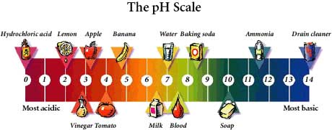
Neutral: substances that are neither acidic nor basic
Water
pH is a measure of the concentration of hydrogen ions in a solution. It means the “power of hydrogen” and refers to the formation of hydrogen atoms that have lost an electron (ions).
*** Copy the numbers from the above scale***

Slide 3
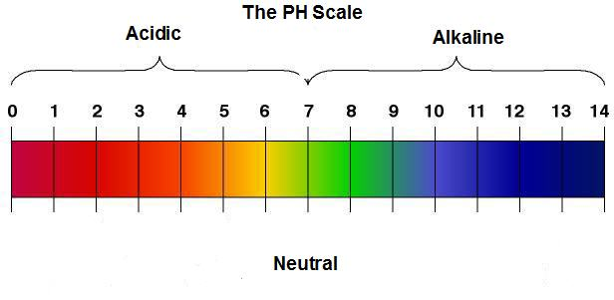
pH: Powerful Scale
The strength or concentration of an acid or base determines the extent to which it reacts with water. The pH scale is a way of comparing the relative acidity or alkalinity of a substance.
To identify a substance as an acid, a base, or neutral, an indicator is used. It changes color according to the type of substance it is put into
Common indicators: litmus paper / universal indicator paper / phenolphthalein / BTB (Bromothymol Blue) grape Juice / red cabbage Juice / tea
Red litmus paper will turn blue in the presence of a base.
Blue litmus paper will turn red in the presence of an acid.

Slide 4
Neutralization
Acids and bases react together when they are mixed. This type of reaction is called neutralization. Both the acid and the base are used up in this type of reaction. A salt and water are produced.
Base Acid Salt Water
Acid Base Salt Water
Acid in your stomach has a normal pH of 2. Eating quickly, and stress causes your stomach produces an excess amount of gastric acid (giving you heartburn). To neutralize the excess acid, an antacid tablet is swallowed. This antacid is a mild base. (eg. Tums, Rolaids)

