Slide 1
Topic 4: Force, Pressure, and Area

Slide 2
Calculating Pressure
Pressure is a measure of the amount of force applied to a given area.
p = F p = pressure, (Pa, or N/m2)
A F = Force, (N)
A = Area, (m2)
**** 1kPa = 1000 Pa *****
See Handout for calculation questions.
Equipped Against Pressure
Safety equipment is needed in many situations in order to protect our body from injury or accident. Most safety equipment is designed to spread the force over a larger area.
Air bag video:
https://www.youtube.com/watch?v=SSz6y-W-R_A

Slide 3
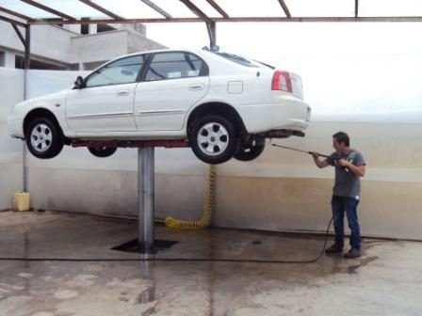
Pascal’s Law
Blaise Pascal discovered that:
Pressure applied to an enclosed fluid is transmitted undiminished in all directions throughout the fluid and perpendicular to the walls of the container.
This is known as Pascal’s Law and it makes hydraulic (liquid) and pneumatic (air) systems possible.
He was the first to notice that the shape of the container had no effect on the pressure at any given depth.
A common application of Pascal’s law is the hydraulic lift.
It is a mechanical system that raises heavy objects, using a fluid under pressure in a closed system.

Slide 4
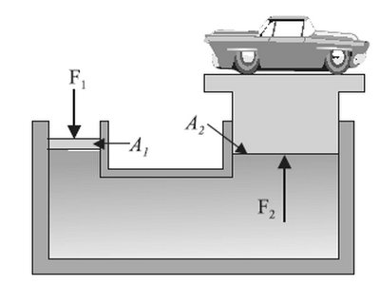
Pascal’s Law and Mechanical Advantage
In hydraulic systems, the pressure is created using a piston. The Input piston is used to apply force to the fluid, which creates pressure in the fluid. The fluid transfers this pressure to the output piston. This pressure exerts a force on the output piston.
See handout for calculations
Larger Force – Greater Distance To Move
To increase the force on the output piston ,
the input piston must move through a greater distance.

