Slide 1
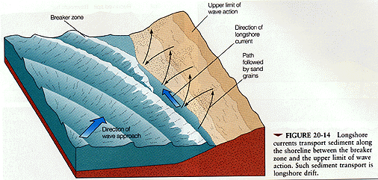
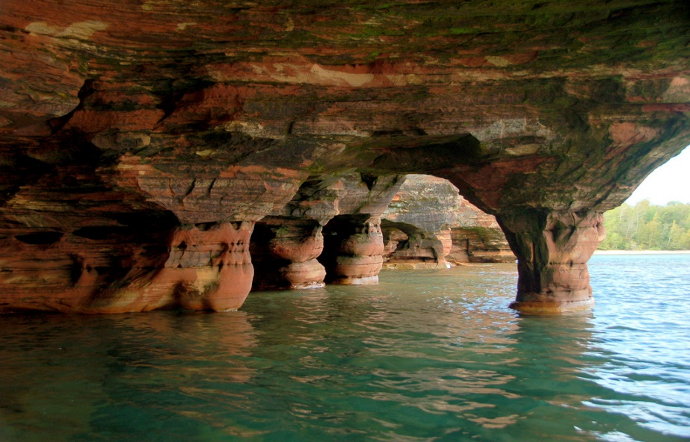
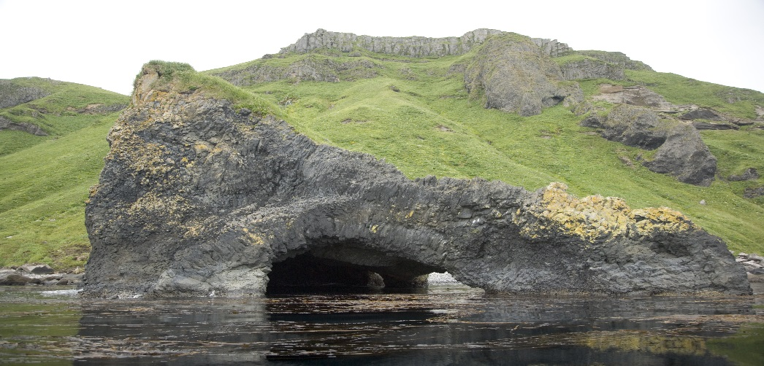
How Waves Change Shorelines
The force of waves crashing against a shoreline can cause changes to the shape of the shoreline, whether it is hard rock or soft rock. Erosion and deposition reshapes the shoreline dramatically. Waves collide with the shoreline at slight angles, creating a longshore current, which carries the sediment along the shore, redepositing it on its journey.
Sea caves and arches can be formed by the action of waves eroding rock along the shore

Slide 2
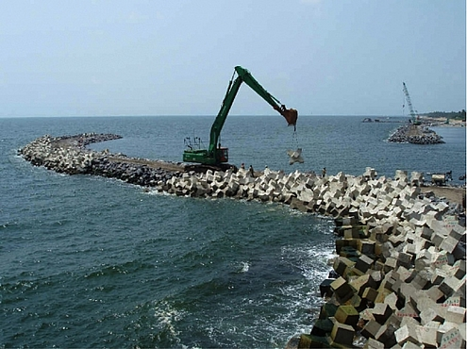
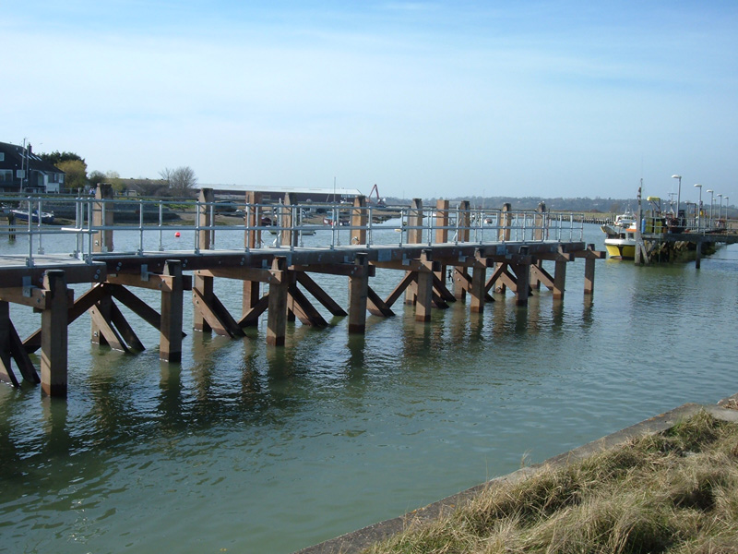
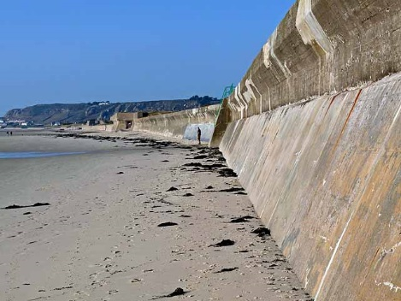
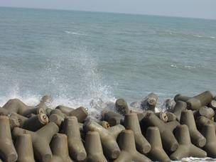
How Beaches Are Formed
The type of rock that the shoreline is made of will determine if it will have a sandy beach or not. If the shoreline is steep and rocky, sand gets washed back to sea. If the shoreline has a gentle slope, then a beach can be formed by the deposition of these tiny fragments of sand. Waves are changing the shores constantly and as a result many beaches have had to have sea walls, breakwaters, jetties and barriers built to prevent the sand from being washed back to sea.

Slide 3
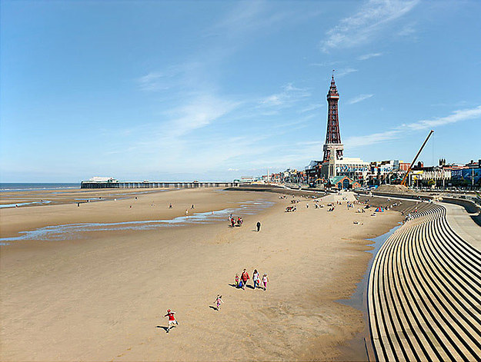
Tides
This water level is called a tide. High tide is the highest level the water will reach on shore, while low tide is the lowest level it will reach onshore. Usually there are two high tides and two low tides each day. The largest tidal movements are spring tides, whereas the smallest tidal movements are called neap tides. The difference in level between high tides and low tides is called tidal range.
https://www.youtube.com/watch?v=-mBvBdGTkR8

Slide 4
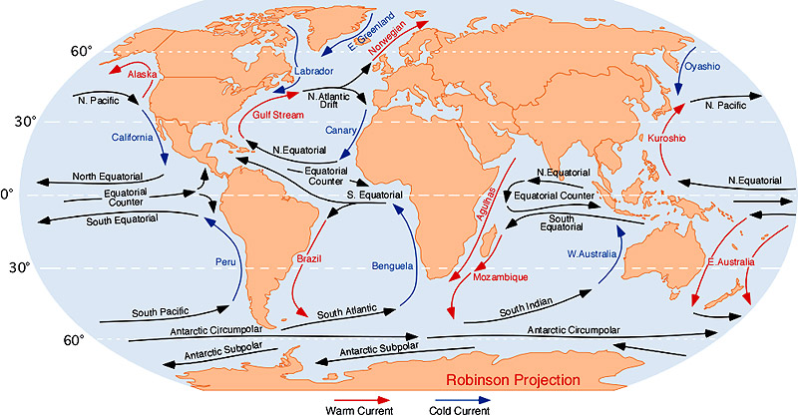
Surface Currents ( WINDS )
Currents of water are driven by winds. The steady flow of ocean currents results from major wind patterns.
There are three factors that influence the direction of winds and surface currents:
• Uneven heating of the atmosphere (convection)
• Rotation of the Earth (bending)
• The continents (deflecting)
A Chinook is a warm dry wind crossing the mountains from west to east.

Slide 5
Ocean and Climate
If a current starts near the equator (like the North Atlantic Current does), it is warm. If they start near the North Pole, they carry very cold water (like the Labrador Current does).
Warm and Cold Currents
Warm ocean currents transfer heat to the atmosphere. Water has a very high heat capacity – meaning it takes a long time to heat up and a long time to loss heat. Large bodies of water hold in the winter, staying warmer than the nearby land. This difference in temperature can affect the convection currents producing breezes that can alter the processes of evaporation and condensation near the shoreline. A cold current can do the opposite.
https://www.youtube.com/watch?v=0KUQKZuhCXU

