Slide 1
Topic 4: The Oceans
70% of the Earth’s surface is covered by the Oceans.
The oceans are in constant change. Surface water and water deep down on the bottom of the ocean floor, is constantly moving across the surface of the Earth, affecting climate, and the diversity of life.
A Sea Full of Salt
Ocean water is salty. The most common salt is sodium chloride, but other salts are also present. The measure of the amount of salts present in a given amount of a fluid is called salinity. Another source of chemicals in ocean water is volcanoes.
https://www.youtube.com/watch?v=hmMlspNoZMs
https://www.youtube.com/watch?v=9yTD1quZ1Uc

Slide 2
Ocean Basins
The oceans form the largest ecosystem on the Earth. Most of the ocean is pitch-black because light can only penetrate about 100m. Scientists have been able to map out the floor of the ocean with sophisticated instruments, so we can ‘see’ what it is like.
A Journey On The Ocean Floor
The origin and formation of the ocean basins are due to mainly the movement of the Earth’s tectonic plates.

Slide 3
Ocean Floor Features
https://www.youtube.com/watch?v=HVJNLSwCGHc
Continental Shelf and Slope
Ocean basins do not begin at the coastline, but many kilometres out at sea.
The continental shelf is the submerged part of a continent and stretches out from the coast 30 - 300km or more. These shelves gradually slope away from the land before dropping steeply at the edge of the shelf. From the edge of the shelf, the continental slope (usually less than 200km wide) plunges 3km at a steep angle to the ocean floor (abyssal plain).

Slide 4
Ocean Waves
Causes of Water Waves Most waves are caused by the wind (a force). Stronger forces cause larger waves.
The Movement Of Water Waves
Although waves can move a very long distance, the water doesn't move - it acts as the medium for the 'wave action' to occur. Waves begin on the open sea. The smooth waves near the shore are caused by winds and storms far out at sea and are called swells.
https://www.youtube.com/watch?v=8YkILSCVibY
Tsunamis are very large waves caused by undersea earthquakes, seabed slides, or large volcanic eruptions. They occur approx. every 5-15 years but have no definite pattern and cannot be predicted.

Slide 5
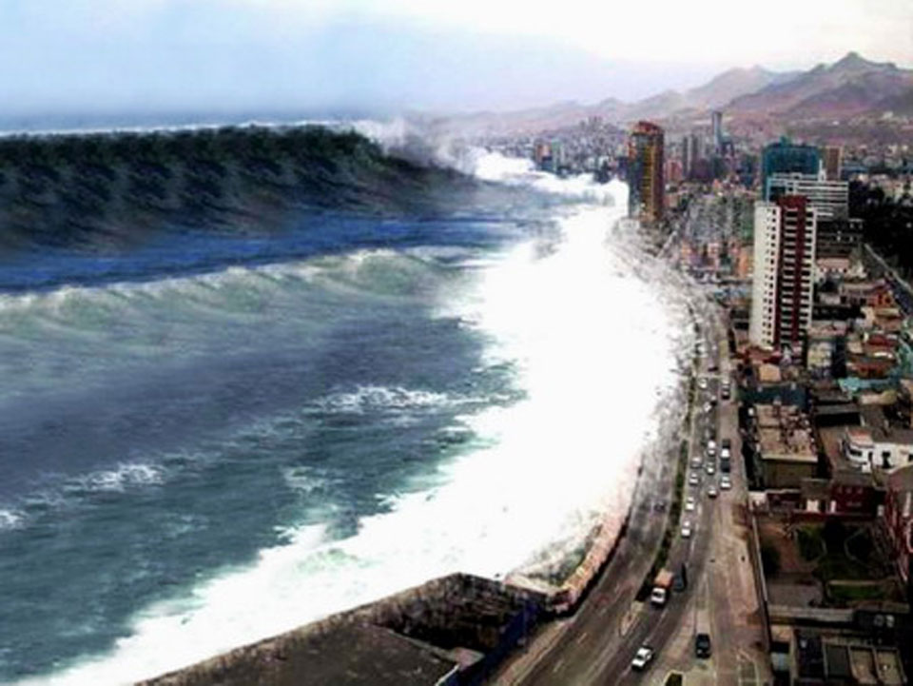
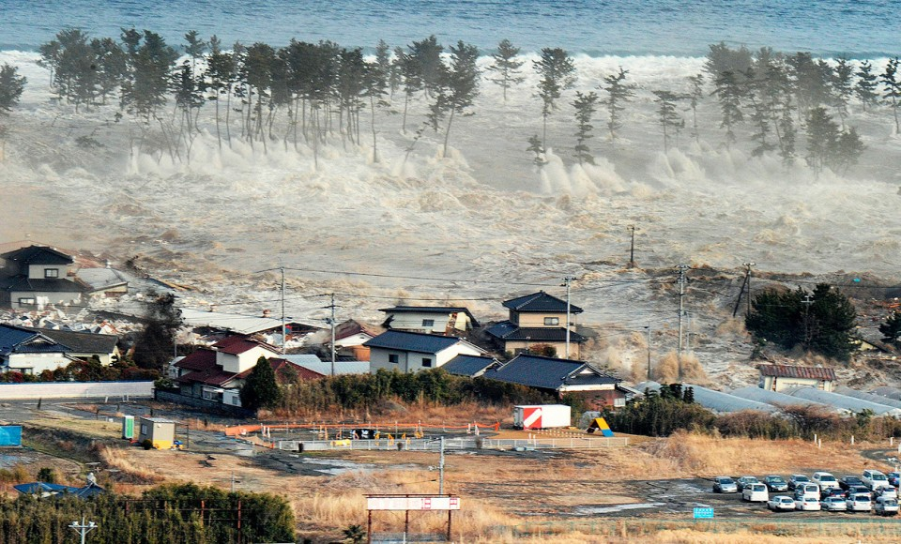
Breaking Waves
As waves get closer to the shore, the illustration shows what happens. Waves that collapse on the shore are called breakers.
Surfers use these forward motions of the crest to ride a wave to shore.
https://www.youtube.com/watch?v=_GCWXzRTQRM

