Slide 1
Topic Four: Fluid Movement in Cells
Cell Membrane
This allows certain materials to enter and leave the cell.
It is called selectively permeable because it lets some materials cross it and stops others.
*** Membranes that let all substances pass are permeable.
*** Membranes that let no substances pass are impermeable.

Slide 2
Diffusion
When particles spread out because of collisions.
Diffusion in Cells
Diffusion helps move substances through the cell membrane.
When particles diffuse they move from areas that have more particles to less particles.
Particles continue moving until there is an equal number on each side of the membrane.

Slide 3
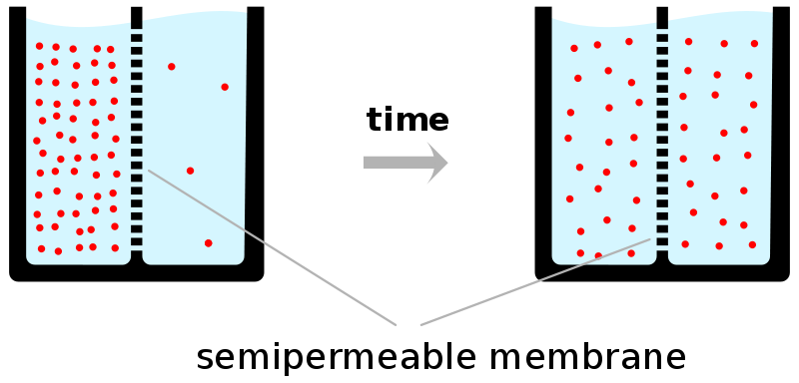
Cell Membrane

Slide 4
Osmosis
diffusion of only water through a selectively permeable membrane.
Water moves into and out of cells by osmosis.
Water moves from an area with more water particles to an area of less water particles. (Same as diffusion)
http://www.youtube.com/watch?v=sdiJtDRJQEc
http://www.youtube.com/watch?v=0c8acUE9Itw

Slide 5
Fluid Movement in Plants
Plants require a large supply of water to make sugars in the process of photosynthesis. A group of cells, that perform similar functions, are called tissue. The transportation of nutrients is the role of plant tissues.
Vascular tissues connect the roots to the leaves.
Phloem Tissue transports sugars manufactured in the leaves to the rest of the plant.
Xylem tissue conducts water and minerals, absorbed by the root cells, to every cell in the plant.
* Xylem and Phloem tissue usually occur together, along the length of plant stems and roots

Slide 6
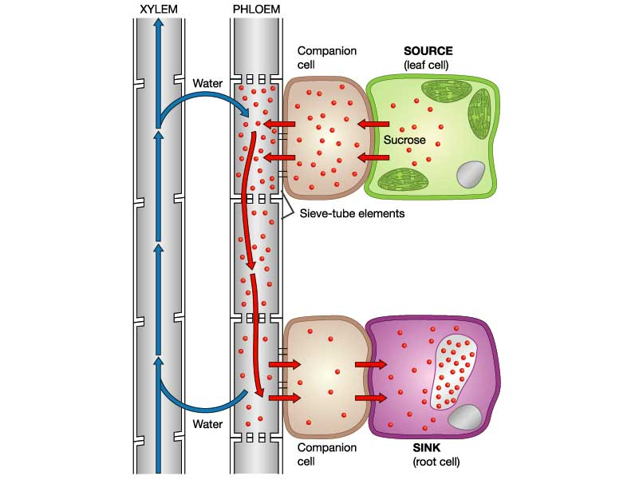
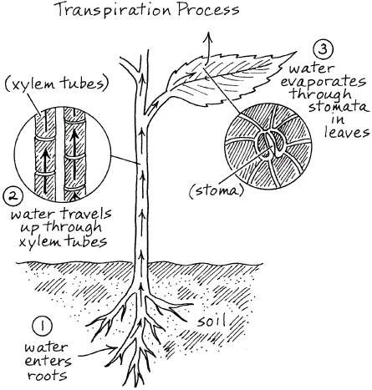
https://www.youtube.com/watch?v=xGCnuXxbZGk

