Slide 1
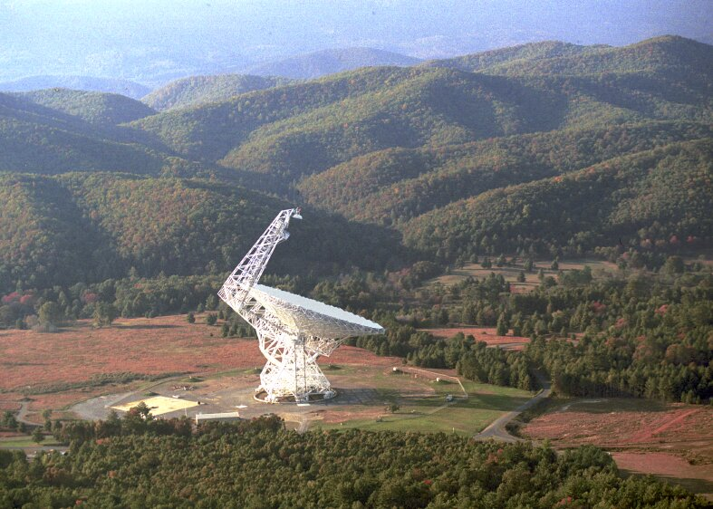
Space Exploration
Topic 4: Bigger and Smarter Telescopes

Slide 2
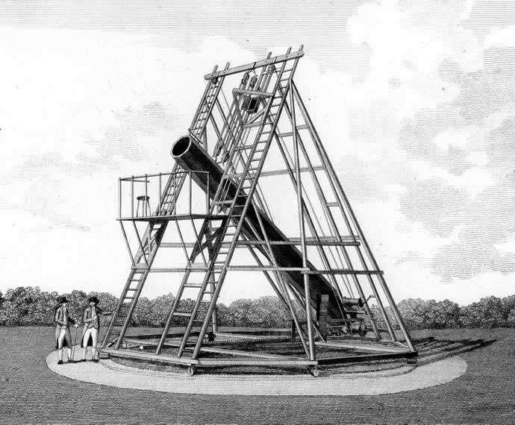
History
In 1773 Herschel invented a large reflecting telescope and discovered Uranus. This was the first “new” planet.

Slide 3
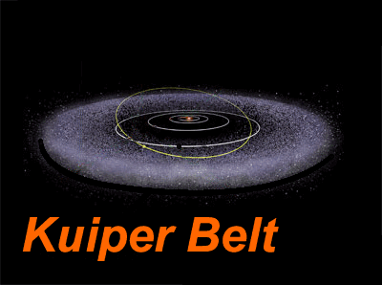
In late 1800’s Kuiper found methane gas in Saturn’s moon with the largest refracting telescope (approx 1 m) in the world at that time.

Slide 4
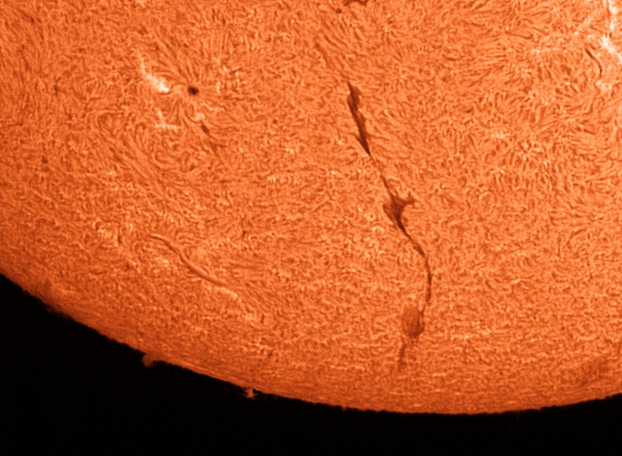
Currently computers now combine images from two or more telescopes. The resolving power now would allow you to distinctly see an orange from 800 km away, (approx distance from Edmonton to Kamloops BC).

Slide 5
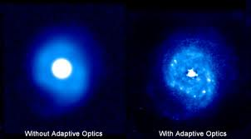
Adaptive Optics
Stars “twinkle” because of light pollution caused by the motion of the Earth’s atmosphere. This “twinkling” does not allow a clear view. To correct this problem computers are connected to telescopes. The computer controls the objective mirror and distorts it a specific amount to cancel the “twinkling”.
http://www.youtube.com/watch?v=KwjZkeLgGZQ

Slide 6
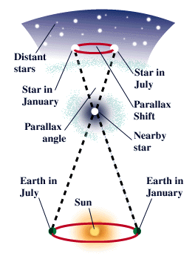
Triangulation/Parallax Technique
You use this method to determine an unknown distance indirectly, (without a tape measure, metre stick, ruler etc.)
See Investigation 5F page 390 READ THIS.

Slide 7
Astronomical Units & Light Years
1 AU (astronomical unit) is 150 million km (150 000 000 km)
These units are not used that often because they are tiny in comparison to universe distances. A star that is close to Earth could be 300 000 AU from Earth.
Light Years are more commonly used.
1 light year is 63240 AU. A star that is close to Earth could be 4.74 light years from Earth. (It would take about that long to travel to the star.)
http://www.youtube.com/watch?v=-pWzcvZTtdU

