Slide 1
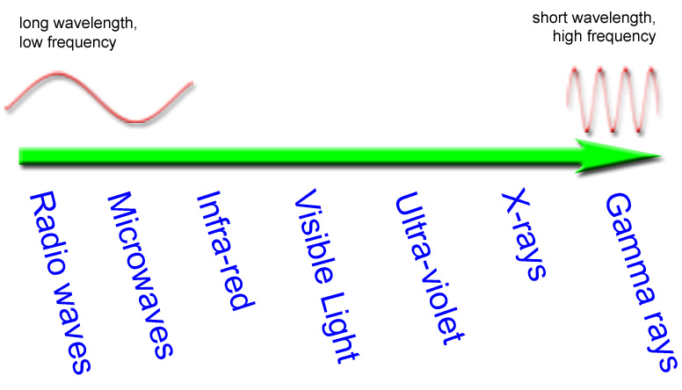
Topic 8: Beyond Light
The sun is the most abundant source of direct natural light on the Earth. The tiny band of visible light that we see is only part of the entire spectrum of light energy we receive. Called the electromagnetic spectrum, because the light waves, electrical and magnetic fields vibrate as they radiate to earth. Different colors on the electromagnetic spectrum have different wavelengths (nanometers) and different frequencies (hertz).

Slide 2
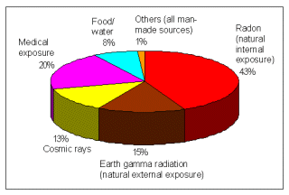
Radiation in the Environment
Radiation is a natural part of our environment. Natural radiation reaches earth from outer space and continuously radiates from the rocks, soil, and water on the earth. Levels of this can vary greatly. A lot of our natural exposure is due to radon, a gas which seeps from the earth's crust and is present in the air we breathe.

Slide 3
Radiation and Life
Sunshine is one of the most familiar forms of radiation. It delivers light, heat and suntans. There would be no life on earth without lots of sunlight, but we have increasingly recognized that it may be dangerous so we control our exposure to it. Sunshine consists of radiation in a range of wavelengths from long-wave infra-red to shorter wavelength ultraviolet. Beyond ultraviolet are higher energy kinds of radiation which are used in medicine and which we all get in low doses from space, from the air, and from the earth. It can cause damage to matter, particularly living tissue. At high levels it is therefore dangerous, so it is necessary to control our exposure.
https://www.youtube.com/watch?v=wQmnztyXwVA
Infrared Radiation Radio Waves
Microwaves have the shortest wavelength and the highest frequency of the all the radio waves.
motion sensors detect speeding cars
• burglar alarms send telephone, satellite and television communications
• heat lamps treat muscle soreness

Slide 4
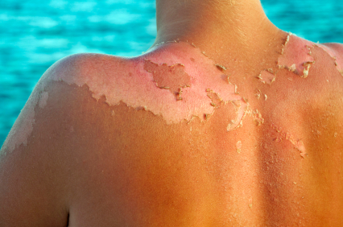
Visible Light Ultraviolet Radiation
(ROYGBIV) damage the cornea of the eye
Red, Orange, Yellow, Green skin cancer
Blue, Indigo, Violet minor skin burns
X – Rays
waves pass through tissue (skin and muscle) and are absorbed by the bones.
stays in the bone and builds up over time
Over – exposure can cause bone cancer
Gamma Rays
Gamma rays result from nuclear reactions and can kill cells.
This can be useful if the cells being destroyed are harmful - like cancerous cells. The cancerous growth of cells and tissue can be radiated, using gamma rays, and is known as radiation therapy.
https://www.youtube.com/watch?v=Ay2VFGDsxac

