Slide 1
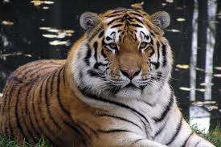
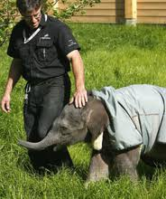
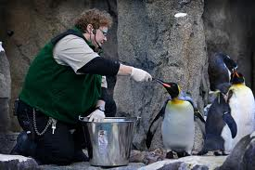
Topic 8: Pains and Gains
The Roles of Zoos in Preserving Biodiversity
Zoos were not originally started to preserve diversity. They were exotic collections for private collectors. They didn’t become public until the early 1800’s – in London. Today there are thousands around the world. The Calgary Zoo is known as one of the finest zoos in the world. It now is home to over 1100 species, including endangered species such as the Whooping Crane and the Siberian Tiger. It is also part of a worldwide network that is attempting to protect and preserve endangered species. Animal exchange programs help to increase the genetic diversity essential to species survival. Support for research is also a large part of their program. Zoos are visible evidence of our attempt to preserve and maintain biological diversity.

Slide 2
Preserving the Biodiversity of Plants
Preserving global biological diversity is a challenge that is receiving much attention. Ex-situ conservation refers to conservation of components of biodiversity outside of a natural habitat. Examples include:
The collection and storage of genetic resources, such as seeds (IPGRI) London, England’s Royal Botanic Gardens is one of the world’s largest seed banks. The goal is to collect 10% of the world’s seed-bearing plants.
http://www.youtube.com/watch?v=sgNEOVlqils
Zoos (captive breeding programs) Calgary Zoo
http://www.youtube.com/watch?v=VZuNvdOsV8k
Sperm and Egg Banks / Gene Banks
http://www.youtube.com/watch?v=ZImiXgU6bCk
Human Genome Project

Slide 3
A Global Effort
The preservation of biological diversity depends on local efforts and global efforts. The 1995 Canadian Biodiversity Strategy was created to preserve biodiversity in Canada. It will be done through the cooperation of many levels of government, along with many groups, agencies and individuals, who are dedicated to preserving our bio-diverse future.
• Protected Areas (National Parks),
• Restoration Programs for Ecosystems and Species (Governments and Nature Conservancy of Canada programs to purchase land for species habitat renewal)
• Resource Use Policies (Laws - Wildlife Act, 1998)
• Controlling the Introduction and Spread of Exotic
• Global Treaties: 1975 Convention on International Trade of Endangered Species (CITES) is aimed at preventing endangered plants and animals from being imported or exported. It is illegal to buy or sell animals or animal parts identified for protection by CITES.

