Slide 1
Topic 2: Stronger Eyes

Slide 2
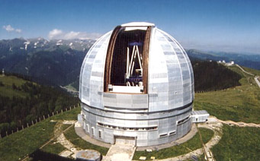
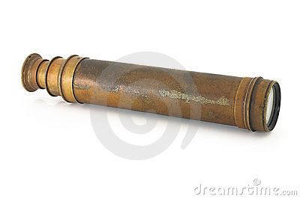
Telescopes
Telescopes allow us to see objects that are very distant in space.
Optical Telescopes
Lippershey made one of the first telescopes, Galileo Galilei made practical use of it.
The observations he made included:
• The moon had blemishes (mountains and craters like the Earth).
• Sun spots indicated that it rotates on its axis.
• Jupiter’s moons orbit the planet.
• Planets were disk-shaped, but because the stars were still pinpoints, they were further away.
http://www.youtube.com/watch?v=K6AHDhmJXKo

Slide 3
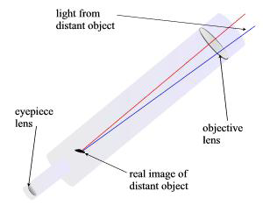
Galileo’s Approach to Inquiry
Galileo’s observations supported Copernicus’s Sun-centered model but not Ptolemy’s Earth-centered model. The reason for his beliefs was that, the moons he observed orbiting Jupiter, indicated that the earth was not the centre of the universe.
Resolving Power/Magnification
Resolving power is the kind of power that produces finer detail of the object being viewed because of the diameter of the objective lens. There is a limit to the size of lens that a refracting telescope can have. Diameters over 1 meter will cause the lens to warp.
See Handout on Resolving Power
Refractors and Reflectors
Optical telescopes are ‘light collectors’. There are two types of optical telescopes:
The first telescope designed was a simple refracting telescope. It uses two lenses to gather and focus starlight

Slide 4
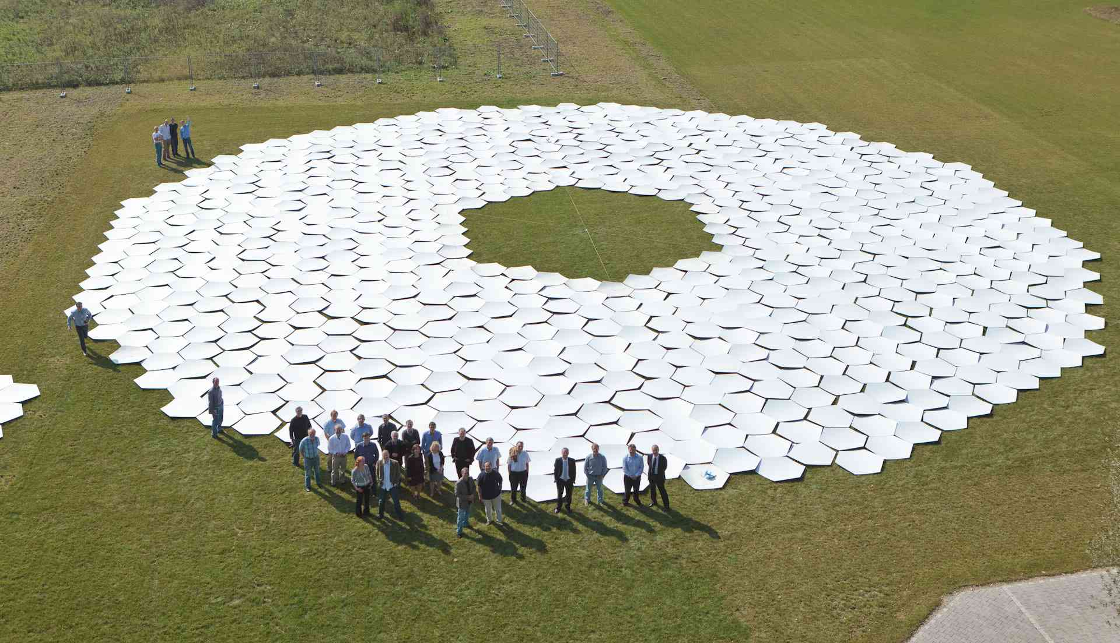
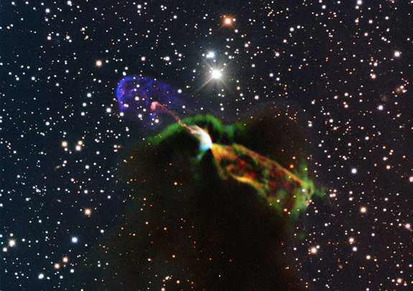
Reflecting telescopes use mirrors instead of lenses to gather and focus the light from the stars. A process called ‘spin-casting’ today makes mirrors, by pouring molten glass into a spinning mould. The glass is forced to the edges, cooled and solidified. Mirrors as large as 6m across have been made using this method.
An innovation for ground-based optical reflecting telescopes is the use of segmented mirrors (a segmented-mirror telescope uses several lightweight-segments to build one large mirror).
Interferometry: Combining Telescopes for Greater Power. The technique of using a number of telescopes in combination is called interferometry. When working together, these telescopes can detect objects in space with better clarity and at greater distances than any current Earth-based observatory. http://www.youtube.com/watch?v=InaCCSVotYw

Slide 5
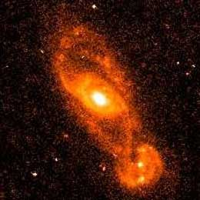
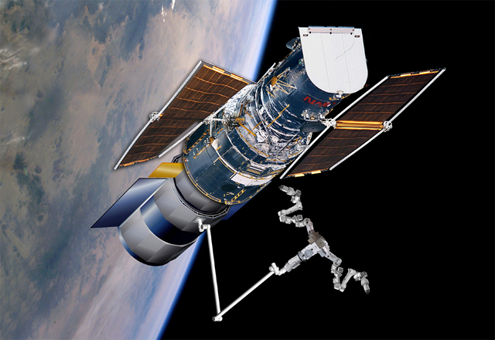
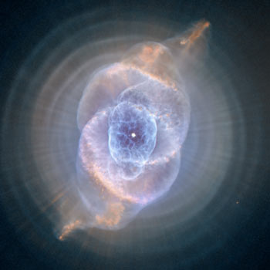
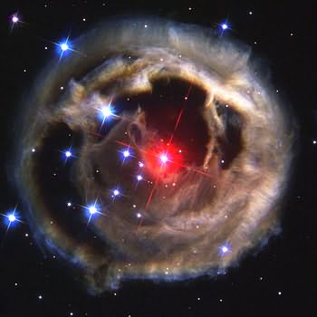
To improve the views of space, astronomers are able to access images from a telescope in space. Free from the interferences of weather, clouds humidity and even high winds, the Hubble Space Telescope, launched in 1990, orbits 600 kms above the Earth, collecting images of extremely distant objects. It is a cylindrical reflecting telescope, 13 m long and 4.3 m in diameter. It is modular (parts can be removed and replaced) and is serviced by shuttle astronauts.
http://www.youtube.com/watch?v=Lmx19_0GX8o
http://hubblesite.org/gallery/

Slide 6
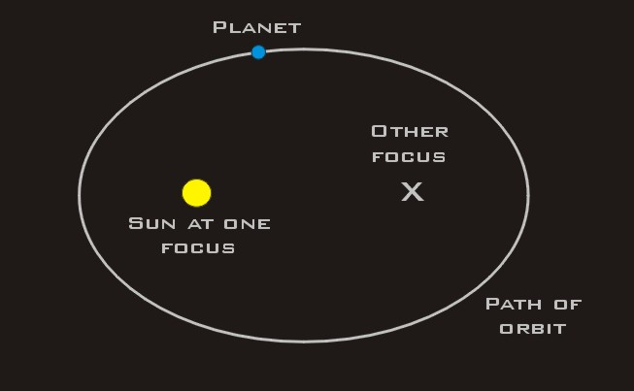
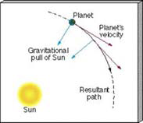
Copernicus’s Sun-centred Revolution Continues
Although Galileo’s observations helped to confirm the Sun-centered model of the universe, it was Johannes Kepler who proved the theory mathematically. To do this, his calculations insisted that the orbits of the planets should be elliptical, instead of circular. He also figured out the shape and scale of the entire known solar system.
Universal Gravitation
Isaac Newton stated the law of universal gravitation eighty years after Kepler’s contribution about elliptical orbits of the planets. Newton’s law states that there is a gravitational force between all objects that pulls them together. An orbit is the result of the attractive force of gravity balancing the straight forward movement of a planet because of velocity.

