Slide 1
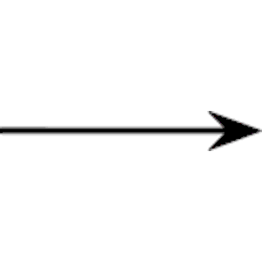
Acid Precipitation – A Global Concern
Sulfur, nitrogen and carbon oxides emitted from industries (such as smelters) combine with water vapor in the air to produce sulfuric, nitric and carbonic acid.
SO_{2(g)} + H₂O_{(l)} H₂SO_{3(aq)} [ sulfurous acid ]
SO_{3(g)} + H₂O_{(l)} H₂SO_{4(aq)} [ sulfuric acid ]
2NO_{2(g)} + H₂O_{(l)} HNO_{2(aq)} + HNO_{3(aq)} [ nitrous and nitric acid ]
CO_{2(g)} + H₂O_{(l)} H₂CO_{3(aq)} [ carbonic acid ]
These pollutants then fall to the ground as acid precipitation (with a pH lower than normal rain - which is about 5.6)
Consequences of Acid Precipitation
chemical change reduces soil fertility delays tree growth
kills organisms in lakes & streams corrodes exposed metal surfaces
leaches toxic chemicals from the soil breaks down stone and limestone damages or destroys aquatic ecosystems
Acidity is measured on the pH scale with anything below 7 being acidic. A decrease of one unit indicates the acidity has been multiplied by a factor of 10.

Slide 2
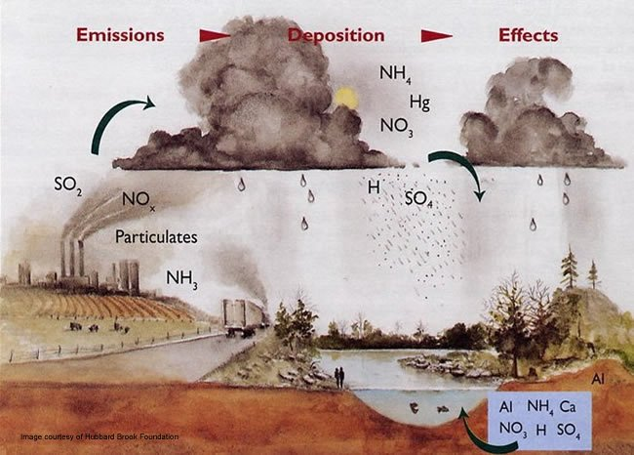
Periods of extreme acidity (like in the spring when the acid snow melts and the acidic water enters the waterways) are called acid shock.

Slide 3
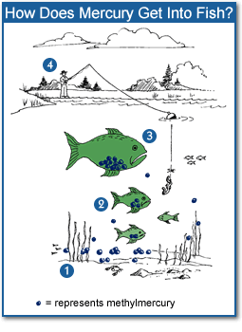
International Agreements
In 1996 an agreement between Canada and the US targeted a 10% reduction in industrial exhaust emissions by the year 2000. As a result total emissions are on the decline.
Acid precipitation dissolves minerals in the soil and allows them to be washed or leached away, leaving fewer nutrients for plants to grow healthy.

Slide 4
International Agreements
In 1996 an agreement between Canada and the US targeted a 10% reduction in industrial exhaust emissions by the year 2000. As a result total emissions are on the decline.
Acid precipitation dissolves minerals in the soil and allows them to be washed or leached away, leaving fewer nutrients for plants to grow healthy.
Using Chemistry to Control Acid Effects
To neutralize acid rain precipitation, lime (calcium hydroxide - which is a base) is added to lakes.
Calcium Hydroxide + Sulfuric Acid ------ » Calcium Sulfate + Water Ca(OH)₂ + H₂SO₄ ------ » CaSO₄ + H₂O
This is not necessary in Alberta because the mountains contain rich deposits of limestone, making the water naturally basic. When the acid rain falls, it is neutralized almost immediately.
http://www.youtube.com/watch?v=5cqCvcX7buo

Slide 5
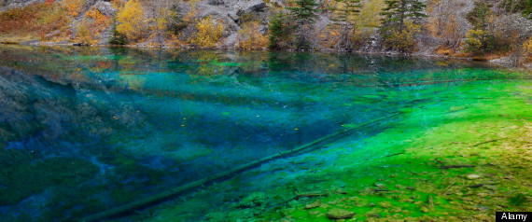
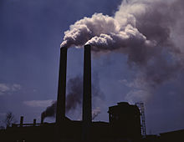
Using Chemistry to Control Harmful Emissions
The concentration of chemicals in the environment can be changed using different techniques. Dispersion is the scattering of a substance away from its source.

Slide 6
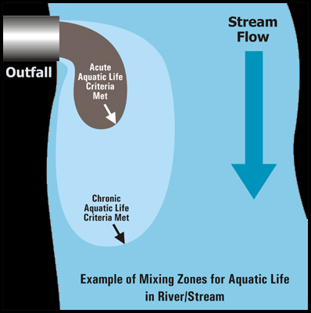
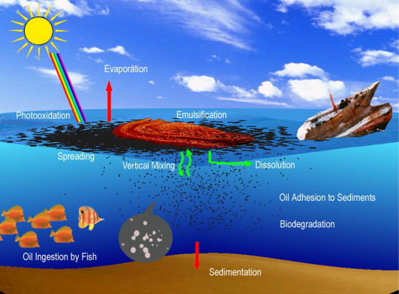
Dilution reduces the concentration of a pollutant by mixing it with large quantities of air or water. A fast flowing river or air mass can disperse and dilute a chemical very quickly.
Biodegradation may also be an effective alternative.

Slide 7
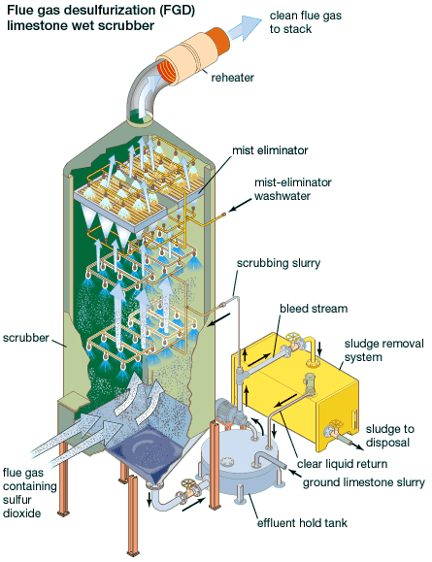
Reducing emissions at the source is more economical and more effect.
Catalytic converters are coated with a thin layer of metallic catalysts, which speed up chemical reactions, without being used up. A converter helps the formation of CO₂ and H₂O, reducing CO and NO₂. The purpose of the converter is to encourage complete oxidation.
http://www.youtube.com/watch?v=1e9EvrThk1Y
Scrub Those Cares Away
The oxide emissions from industries and thermal-electric power plants that burn coal are a major source of oxides. The addition of ‘scrubbers’ is a technological solution to reduce oxide emissions. They “catch” sulfur oxides.

Slide 8
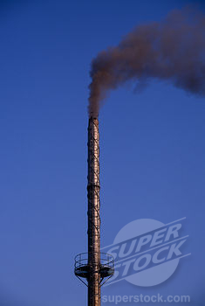
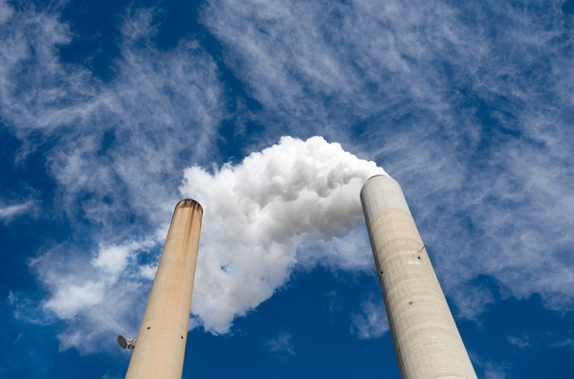
Without Scrubber
With Scrubber

