Slide 1
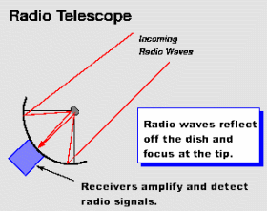
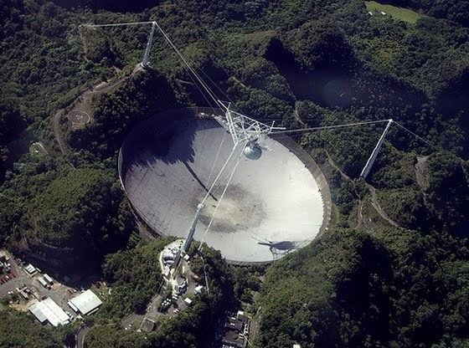
Topic 5 - What Channel Is This?
Radio Telescopes
Radio waves are received from stars, galaxies, nebulae, the Sun and even some planets. With the development of radio telescopes, astronomers gain an advantage over optical telescopes, because they are not affected by weather, clouds, atmosphere or pollution and can be detected day or night.

Slide 2
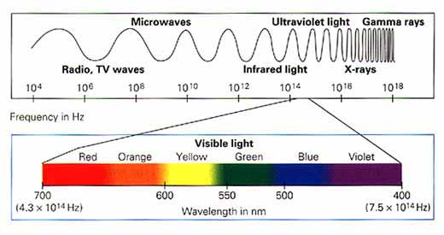
In 1932 Karl Jansky built a radio antenna that was able to identify radio waves from space.
Grote Reber built a radio dish based on Jansky’s antenna findings, where he ‘listened’ to the sky during the 1930’s. He discovered that the strongest radio waves came from specific places in space. The static Rober heard became louder when he tuned into these radio objects. The loudest being our Sun in the Milky Way Galaxy.
http://www.youtube.com/watch?v=LbH8tg8TuUo
Bigger Radio Telescopes
Radio waves have wavelengths that are millions of times longer than light waves, meaning that these waves give less resolution, but can penetrate dust clouds in the galaxy, where light waves cannot.

Slide 3
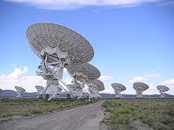
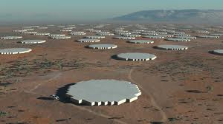
Seeing Radio Waves
Radio telescope waves provide data, which astronomers using computers produce images of the radio waves, which are coded to the strength of the waves.
Blues for low intensity, and as the signal gets stronger the colors go through greens, yellows, reds and whites.
Radio observations have provided a whole new outlook on objects we already knew, such as galaxies, while revealing pulsars and quasars that had been completely unexpected.
http://www.youtube.com/watch?v=EH_OSqIRV18
Connecting Radio Telescopes
By combining several small radio telescopes ( just like they do with optical telescopes ) greater resolving power can be achieved. This is radio interferometry.

Slide 4
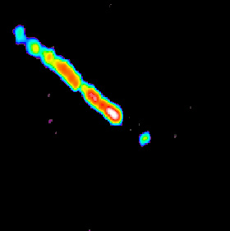
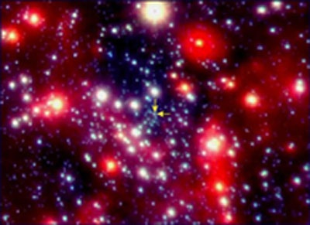
Radio Telescopes Bigger Than Earth
Telescopes can now be connected without wires, because of computers. This method is called Very Long Baseline Interferometry ( VLBI ).
Images 100 times that of the largest optical telescope can be captured.
http://www.youtube.com/watch?v=59Bl8cjNg-Y
Jets from a black hole
Sgr A*
2 astronomical units in diameter which is equivalent to the diameter of the Earth’s orbit around the Sun.

