Slide 1
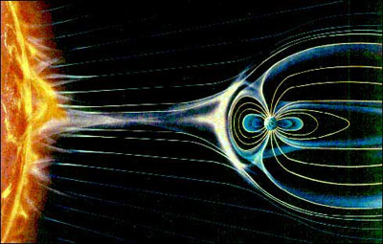
Topic 7: The Solar System Close Up
The Sun
The Sun is made up of mostly hydrogen gas. It is 1.4 million km in diameter. Its temperature is about 15 million degrees Celsius. 600t of hydrogen are converted, by nuclear fusion, into helium per second. This is the energy released from the Sun. The Sun emits charged particles in all directions. This solar wind bombards the Earth at 400km/s, but the magnetic field of the Earth protects us.

Slide 2
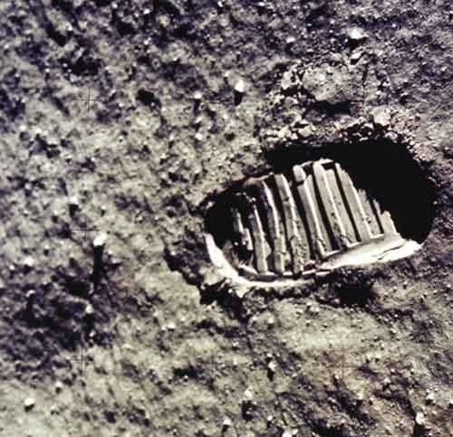
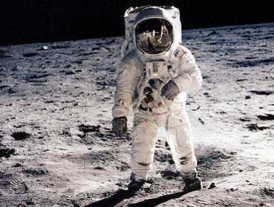
Traveling through The Solar System
The formation of our solar system is based on the ‘protoplanet hypothesis’, which follows three steps:
1. A cloud of gas & dust in space begin swirling
2. Most of the matter (more than 90% of it) accumulates in the center – forming the Sun
3. The remaining materials accumulate (forming planets) and circle the Sun
http://www.youtube.com/watch?v=dm9LTnozHJ0
The Moon
The first other world we could see up close was the Moon. On July 17, 1969 Neil Armstrong and Edwin Aldrin landed on the moon.

Slide 3
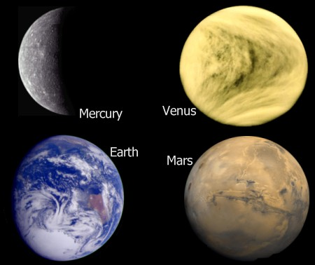
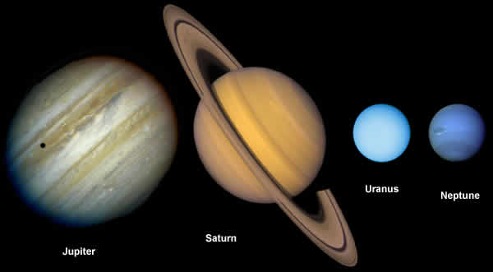
The Inner Planets - Mercury, Venus, Mars and the Earth - are considered the terrestrial planets because of their composition.
The Outer Planets – Jupiter, Saturn, Uranus, Neptune, and Pluto – are similar because of their gaseous composition.
Complete Planet Information Handout

Slide 4
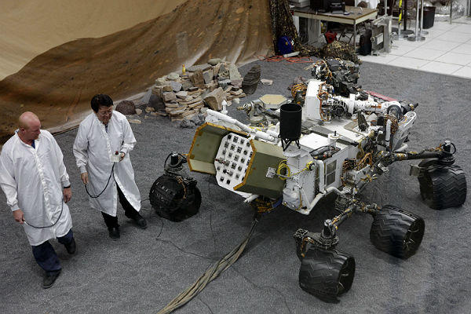
Exploring the Outer Planets
Observation equipment is sent out into space to explore distant areas of our solar system. Space probes are unmanned satellites or remote-controlled ‘landers’ that put equipment on or close to planets. Probes have done remote sensing on Mercury and Jupiter, taken soil samples on Mars, landed on Venus, and studied Saturn’s rings up close. The most recent probes to explore Mars are still there.
They are Spirit, Opportunity and Curiosity (launched Nov 2011 landed Aug 2012)
They are looking for evidence of water to determine if Mars at one time could have sustained life. http://www.youtube.com/watch?feature=endscreen&v=7UUPiCVbZhE&NR=1

Slide 5
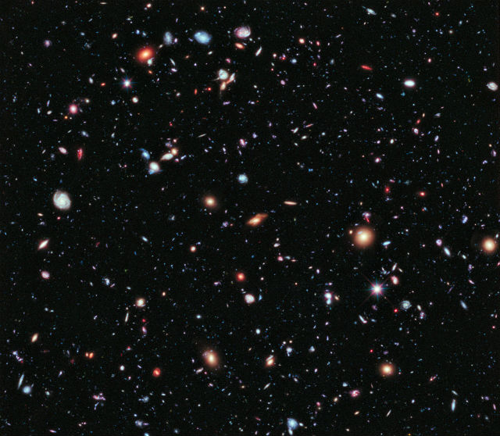
The only place that has been explored by humans in space, other than our Earth is the Moon. Apollo 11 was the first landing and there have been many others since. The next step is to establish a base for interplanetary manned missions to Mars.
Distribution of Space and Matter
When you view an object in the sky you are seeing it as it was in the past. It has taken the light a very long time to reach the Earth. Light from the Sun takes about 5 minutes to reach the Earth, whereas light from Pluto takes about 5 hours. The farther away, the longer light takes to reach the Earth. Light from the stars in the center of the universe takes about 25,000 years to reach the Earth. The Hubble telescope is capturing light from 12 billion years ago.

Slide 6
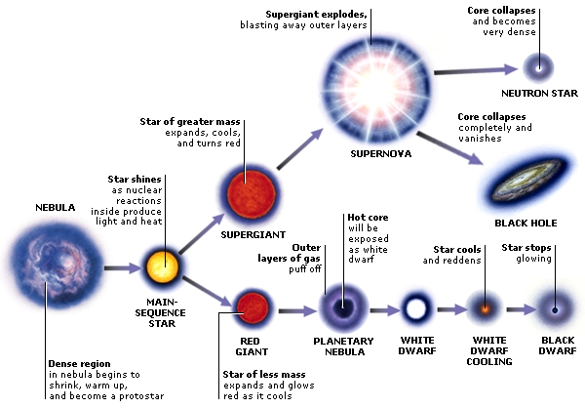
A star is a hot, glowing ball of gas (mainly hydrogen) that gives off light energy. Stars vary in their characteristics. Very hot stars look blue, while cooler stars look red.
The process of ‘star-building’ is known as fusion, which releases great amounts of energy and radiation.

Slide 7
Currently, Voyager 1 is about 18 340 000 000 km from the Earth and Voyager 2 is
14 932 000 000 km from the Earth.
The communication time lag in transmissions is about 23 hours for Voyager 1 and 18 hours for Voyager 2.
http://www.youtube.com/watch?v=rLN7BU25EB0&feature=related

